Slide 1
LECTURE 01: COMMUNICATING WITH DATA
September 8, 2016
SDS 136
Communicating with Data

Slide 2


People
Instructors:
R. Jordan Crouser
jcrouser@smith.edu
Location: Ford 344
Office Hours: W 10am-12p
www.science.smith.edu/~jcrouser
Maggie Lind Newey
mnewey@smith.edu
Location: Smith College Museum of Art

Slide 3
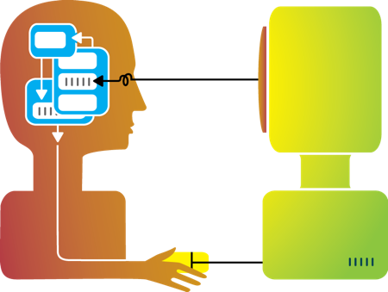
Jordan’s research
Visualization
Cognitive
Science
Interaction
Design
Computational
Modeling

Slide 4

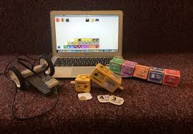
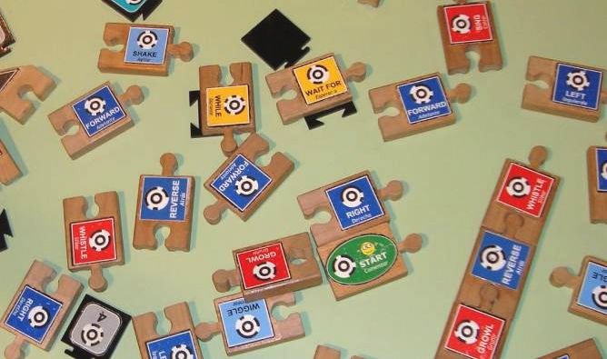
Jordan’s research: educational tech

Slide 5



Jordan’s research: big data analysis

Slide 6





Jordan’s research: computing for mental health

Slide 7



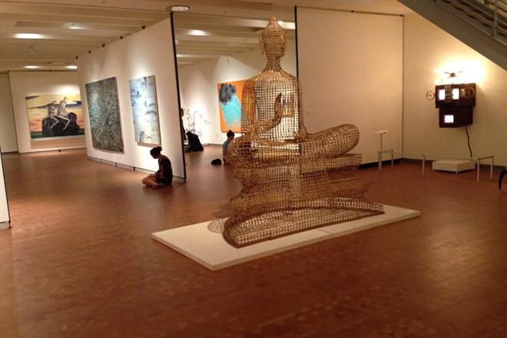
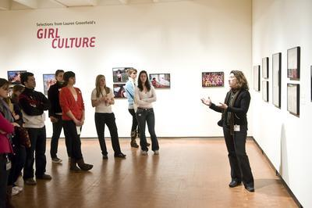
Maggie: Smith College Museum of Art

Slide 8
Your turn!
3 Minute Biographies:
Name and pronouns
Year, school, and (potential) major
Academic background
Have you ever taken a math or CS course before?
How about art or design courses?
3 Questions:
What brought you to this course?
What’s one big thing you hope to get out of it?
What’s one problem / idea / curiosity that sometimes keeps you up at night?

Slide 9
Outline
About this course
How is visualization useful?
What is data?
Structure of this course

Slide 10
About this course
Visualization

Slide 11
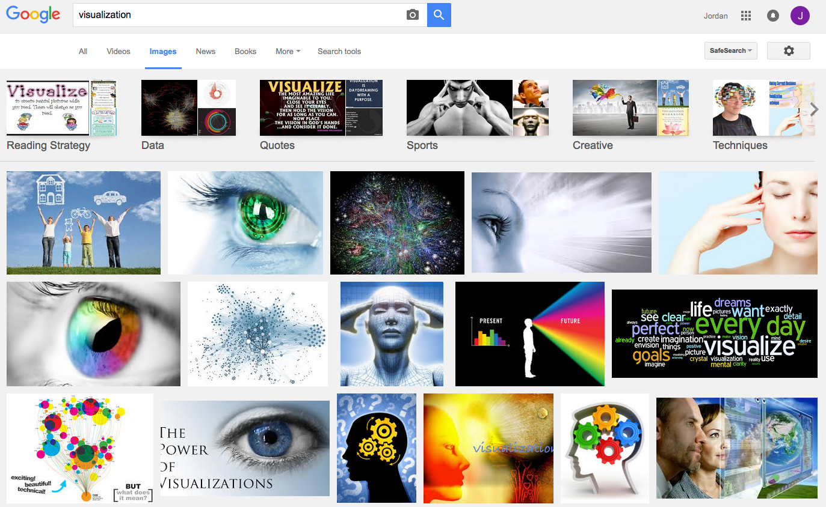
What is visualization?

Slide 12
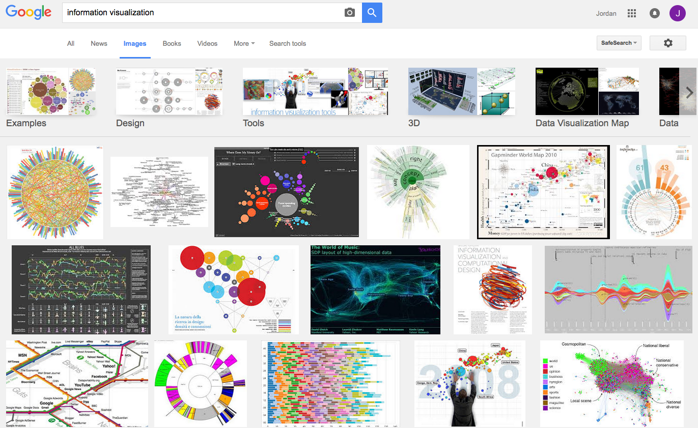
What is visualization?

Slide 13
Perhaps a more helpful question:
What are some ways
a “visualization” can be useful?

Slide 14
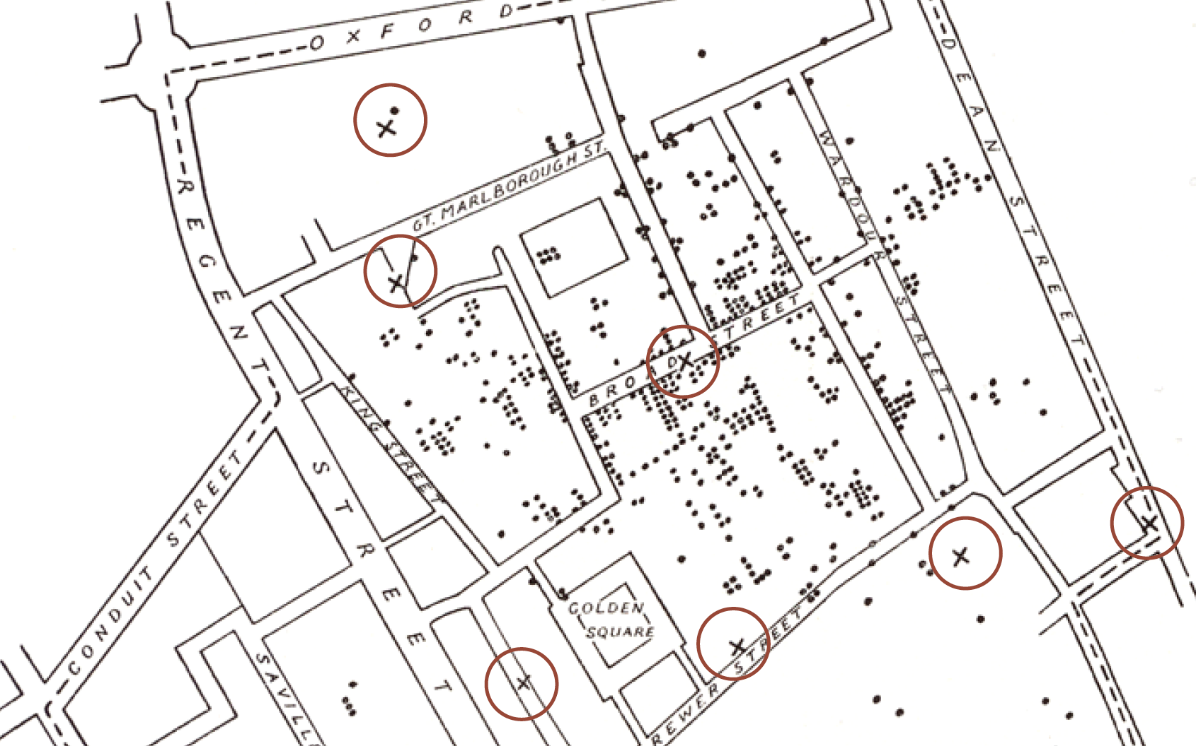
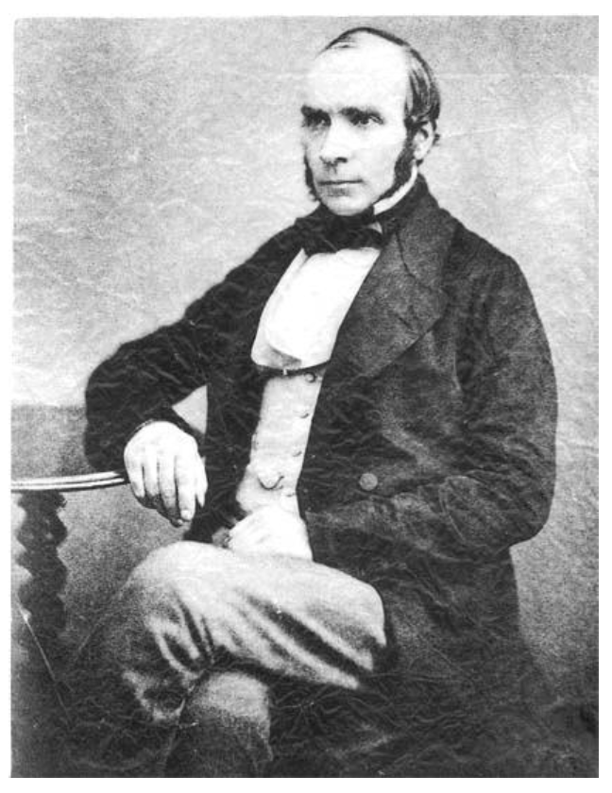
Does it help you spot trends?
In 1854, cholera broke out in London
127 people near Broad St. died within 3 days
616 people died within 30 days
Initial explanation:
“Miasma in the atmosphere”
Dr. John Snow was the first to link the outbreak to contaminated water
How did he do it?
Talked to local residents
Identified a water pump as a likely source
Used maps to illustrate his theory
Convinced authorities to disable the pump
More info here: http://en.wikipedia.org/wiki/1854_Broad_Street_cholera_outbreak

Slide 15
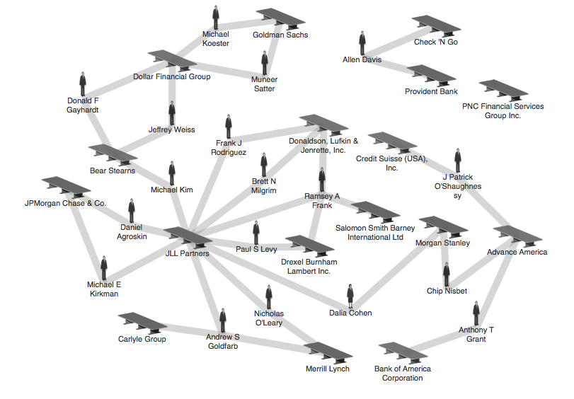
Does it help you explore?
Credit: theyrule.net

Slide 16

Does it tell a story?
Hans Rosling’s 200 Countries, 200 Years, 4 Minutes – The Joy of Stats – BBC Four
https://www.youtube.com/watch?v=jbkSRLYSojo

Slide 17
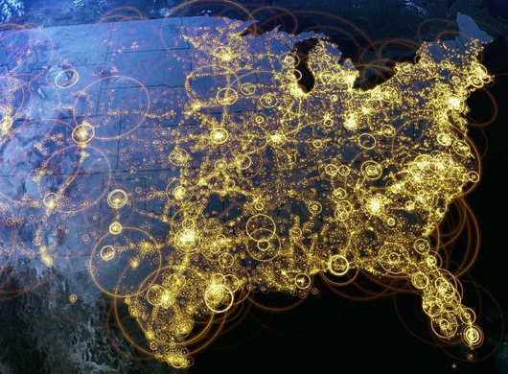
Visualization (def.)
Visual representations of data that reinforce human cognition
Notes:
Image from StackOverflow: http://i.stack.imgur.com/hbO8v.jpg

Slide 18

Wait… what is “data”?

Slide 19

Data: a definition
Data is a set of variables that capture various aspects of the world:
Tuition rates,
enrollment numbers,
public vs. private, etc.

Slide 20

Data: a definition
A dataset also contains a set of observations (also called records) over these variables. For example:
tuition = $46,288,
enrollment = 2,563,
private, etc.

Slide 21
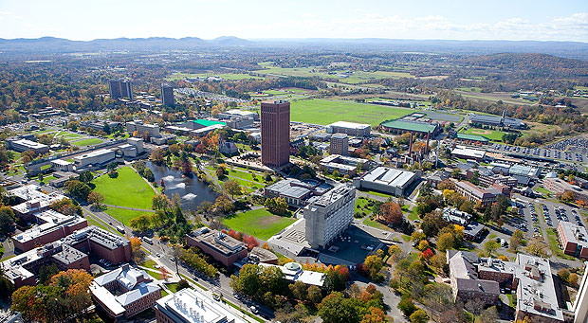

Data: a definition
A dataset also contains a set of observations (also called records) over these variables. For example:
tuition = $16,115,
enrollment = 28,635,
public, etc.

Slide 22
One way to think about this:
VARIABLES
 | Tuition | Enrollment | Public vs. Private | …
Smith College | $46,288 | 2,563 | private
UMass Amherst | $16,115 | 28,635 | public
Hampshire College | $48,065 | 1,400 | private
Mount Holyoke College | $43,886 | 2,189 | private
Amherst College | $50,562 | 1,792 | private
⋮
OBSERVATIONS

Slide 23
Another way to think about this
class school_obs:
def __init__(tuition, enrollment,
pub_or_priv):
self.tuition = tuition
self.enrollment = enrollment
self.pub_or_priv = pub_or_priv
smith = school_obs(46288, 2563, “private”)
umass = school_obs(16115, 28635, “public”)
VARIABLES
OBSERVATIONS

Slide 24

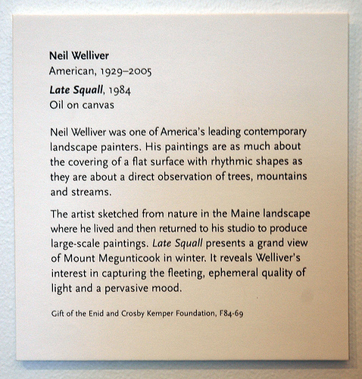
Yet another way to think about this
Information about the artist:
Name, place/date of birth,
date of death (if deceased)
Information about the piece:
Title, date, medium
Information about the donation:
Name of donor, reference number
Curated description and
relevant contextual information
Kinds of information = variables
Actual text on the placard = observations

Slide 25
Data: a definition
Each variable may be either independent or dependent:
An independent variable is not controlled or affected by another variable (e.g., time in a time-series dataset)
A dependent variable is affected by a variation in one or more associated independent variables (e.g., temperature in a region)

Slide 26
Basic data types
Nominal
Ordinal
Scale / Quantitative
Ratio
Interval
An unordered set {…}
of non-numeric values
For example:
Categorical (finite) data
{apple, orange, pear}
{red, green, blue}
Arbitrary (infinite) data
{“12 Main St. Boston MA”, “45 Wall St. New York NY”, …}
{“John Smith”, “Jane Doe”, …}

Slide 27
Basic data types
Nominal
Ordinal
Scale / Quantitative
Ratio
Interval
An ordered set <…>
(also known as a tuple)
For example:
Numeric: <2, 4, 6, 8>
Binary: <0, 1>
Non-numeric:
<G, PG, PG-13, R>

Slide 28
Basic data types
Nominal
Ordinal
Scale / Quantitative
Ratio
Interval
A numeric range […]
Ratios
Distance from “absolute zero”
Can be compared mathematically using division
For example: height, weight
Intervals
Ordered numeric elements that can be mathematically manipulated, but cannot be compared as ratios
E.g.: date, current time

Slide 29
Converting between basic data types
Q → O [0, 100] → <F, D, C, B, A>
O → N <F, D, C, B, A> → {C, B, F, D, A}
N → O (??)
{John, Mike, Bob} → <Bob, John, Mike>
{red, green, blue} → <blue, green, red>
O → Q (??)
Hashing?
Bob + John = ??
Discussion: what do you notice?
Readings in Information Visualization: Using Vision To Think. Card, Mackinglay, Schneiderman, 1999

Slide 30
Basic operations
Nominal (N)
Equality: = and ≠
Frequency: how often does x appear?
Ordinal (O)
Relation to other points: >, <, ≥, ≤
Distribution: inference on relative frequency
Quantitative (Q)
Other mathematical operations: (+, -, *, /, etc.)
Descriptive statistics: average, standard deviation, etc.

Slide 31
Why is this important?
Data have dimensions
Visualizations have dimensions, too
To build visualizations, we need to map data dimensions to visual dimensions

Slide 32
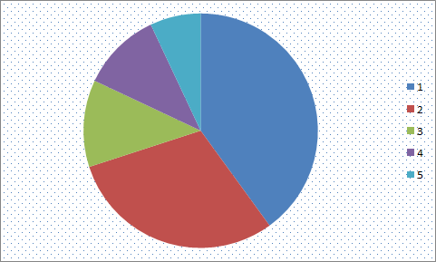
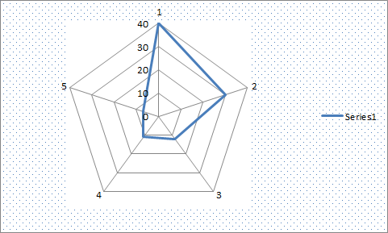
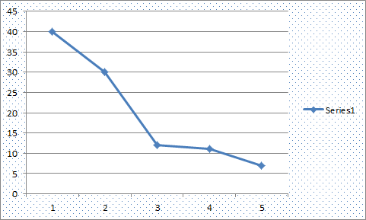
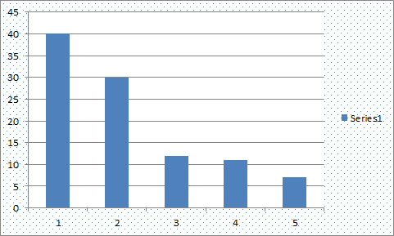
Key question for this course
Which data dimension should be mapped
to which visual dimension?

Slide 33
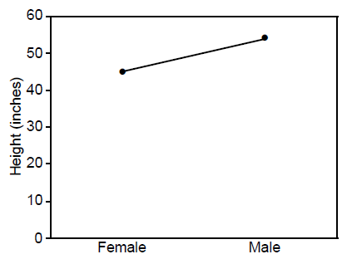
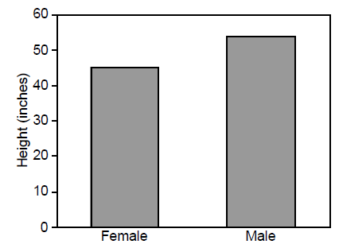
Answer: it depends
Average Height for Youth Sports Participants
Crew Basketball
Crew Basketball

Slide 34
What we’ll cover in this class
Visualization Fundamentals (next class)
Perception
Design Principles
Color Theory
Dealing with Multiple Variables
Text Data
Storytelling with Data
Data-Driven Journalism
Animation and Movement
Interactive Visualization
Visualization Fundamentals (next class)
Perception
Design Principles
Color Theory
Dealing with Multiple Variables
Text Data
Storytelling with Data
Data-Driven Journalism
Animation and Movement
Interactive Visualization

Slide 35
General information
Course website:
http://www.science.smith.edu/~jcrouser/SDS136/
Piazza Q&A is live:
https://piazza.com/smith/fall2016/sds136/home
Syllabus (with slides after each lecture)
Textbooks (none required, reserves available)
Assignments
Grading
Accommodations

Slide 36



Structure of this course
Disclaimer:
this class is an experiment in constructionism
(the idea that people learn most effectively
when they’re building personally-meaningful things)
Our job as instructors:
Notes:
Expose you to some foundational principles and available tools
Ask questions that build your intuitions about identifying problems where visualization techniques can help
Most important: help you find opportunities to solve real problems in areas YOU care about (and hopefully learn some cool stuff about visualization along the way…)

Slide 37
Assignments and grading
Participation (10%): show up, engage, and you’ll be fine
Labs (30%): run during regular class time, hands-on look at how various visualization techniques work
Assignments (40%): built to help you become comfortable with applying the techniques
Course project (20%)

Slide 38

Preparing for labs
Our labs will be run using Tableau, a drag-and-drop visualization tool suite
Tableau for Teaching has donated license keys (good for one year) for everyone enrolled in this course
Instructions for getting a license will be posted to Piazza shortly; please install before next Thursday!
Need help? Ping me or the TAs, or come to office hours

Slide 39
Course project
Various industry partners (VIPs) have offered potential datasets and/or analysis questions
You’re also welcome to propose your own!
Goals:
Learn how to break big, unwieldy questions down into clear, manageable problems
Figure out if/how the techniques we cover in class apply to your specific problems
Use visualization to address them
Several (graded) milestones along the way
Demos and discussion on the final day of class
gain real experience | solve real problems
build real relationships

Slide 40
What you’ll get
By the end of this course, you will:
Know how to use visualization to communicate ideas
Know the foundational methods and tools available
Be familiar with ongoing research in visualization
Have access to guest speakers from really cool places (National labs, other schools, major companies, etc.)
Have (marketable!) experience developing useful visualizations to solve real problems

Slide 41
What I expect from you
You like challenging problems, and you’re excited about “figuring stuff out”
You’re willing to get comfortable asking questions
You’re interested in the perspectives of people with very different backgrounds from your own
You turn things in on time, show up to class, or let me know in advance*

Slide 42
What you can expect from me
I’m flexible w.r.t. the topics we cover:
This course is a collaboration
If there’s something you want to learn that’s not on the agenda, speak up!
I’m happy to share my professional connections:
If there’s a company or school you’d like to work with for your project, let me know and I’ll reach out to them
Note: the best way to get a job/internship/etc. is to convince someone on the inside that you’re awesome
Access:
Office hours on Weds. morning, and by appointment (use my website to schedule)
I respond faster to questions posted to Piazza than to email (priority inbox)
We can explore other options as needed (Google hangout, etc.)

Slide 43
Before next class
Email Jordan if you don’t have a computer that will support Tableau
Post your first Piazza reflection:
What was one thing about today’s class
that surprised you?
What is one question you have
that you hope we’ll answer this semester?

Slide 44
Questions?

